Slide 1
Connecting Devices and Virtual LANs

Slide 2
CONNECTING DEVICES
Connecting devices to connect hosts together to make a network or to connect networks together to make an internet.
Connecting devices can operate in different layer of the internet model.
17.<number>

Slide 3
Connecting Devices
  Repeaters
  Hubs
  Bridges
  Switches
  Routers

Slide 4

Figure Five categories of connecting devices

Slide 5
Repeaters
A physical layer device the acts on bits not on frames or packets
When a bit (0,1) arrives, the repeater receives it and regenerates it, the transmits it onto all other interfaces
It regenerate the signal over the same network before the signal becomes too weak or corrupted so as to extend the length to which the signal can be transmitted over the same network.
do not amplify the signal

Slide 6

Figure Function of a repeater

Slide 7

Figure A repeater connecting two segments of a LAN

Slide 8

Note
A repeater connects segments of a LAN.
A repeater forwards every frame;
it has no filtering capability.
A repeater is a regenerator,
not an amplifier.
15.<number>

Slide 9
Hubs
Acts on the physical layer
Operate on bits rather than frames
Also called multiport repeater
Hub receives a bit from an adapter and sends it to all the other adapters without implementing any access method.
does not do filtering (forward a frame into a specific destination or drop it) just it copy the received frame onto all other links
Multiple Hubs can be used to extend the network length

Slide 10

Hubs

Slide 11
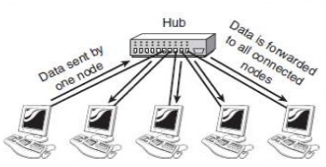
Hubs

Slide 12
Interconnecting with hubs
Advantage:
  Extends max distance between nodes
Disadvantages
  Individual segment collision domains become one large collision domain ➔ (reduce the performance)

Slide 13
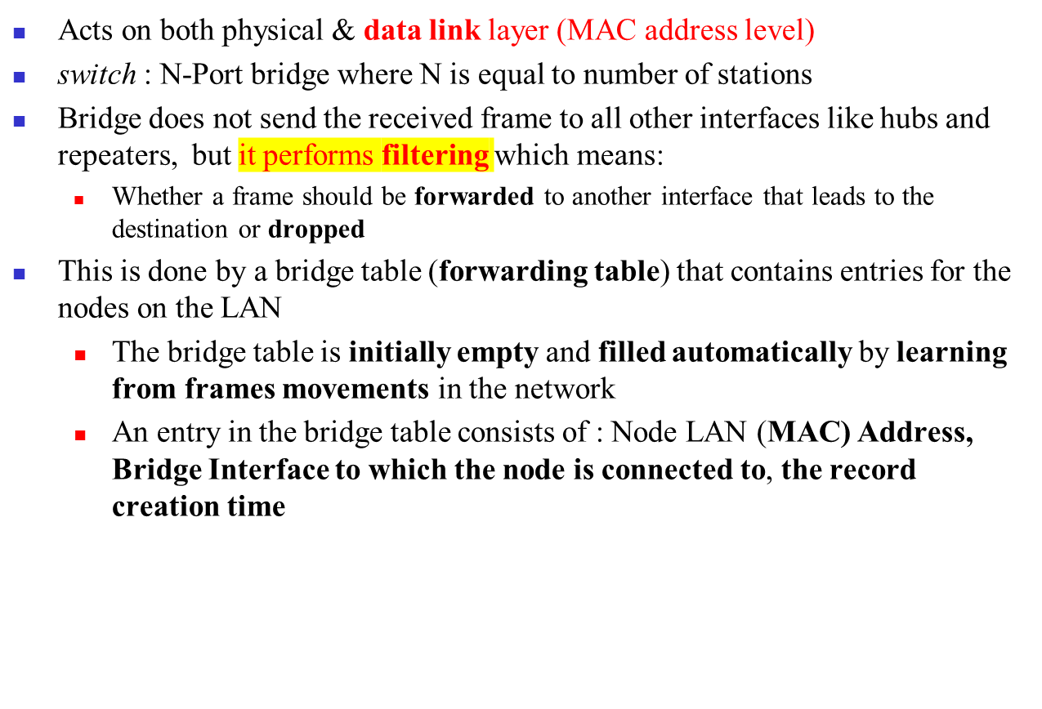

Bridges/switches

Slide 14
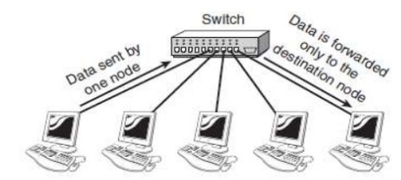
Bridges

Slide 15

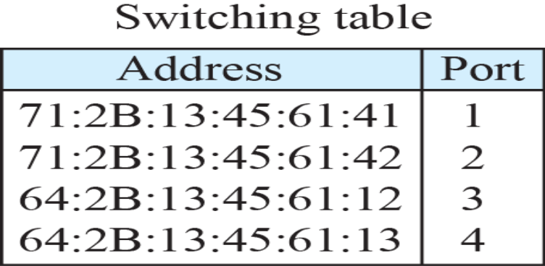
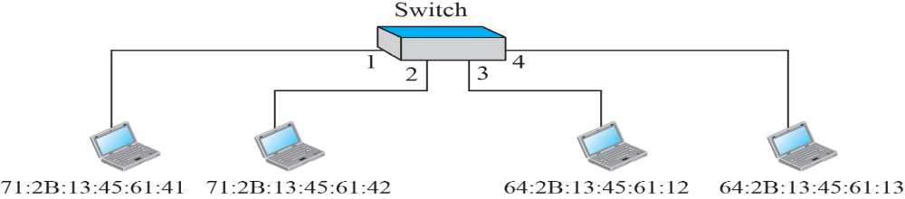
Figure A bridge connecting two LANs

Slide 16
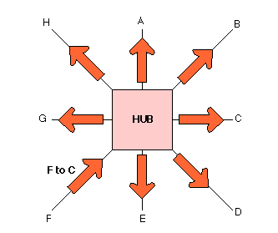
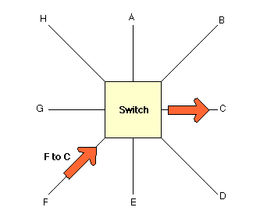
Bridges (Switches) Vs. Hubs
A Hub sending a packet form F to C.
A Switch sending a packet from F to C

Slide 17
Note
A bridge has a table used in
filtering decisions.
A bridge does not change the physical (MAC) addresses in a frame.
15.<number>

Slide 18
Backbone network
A backbone network is the central part of a computer network that interconnects different parts (subnetworks, LANs, or smaller networks) and carries the majority of data traffic. You can think of it as the main highway in a road system that connects different local roads together.
It ensures high speed, reliability, and scalability, allowing different smaller networks to communicate efficiently.

Slide 19
Real-Life Examples:
University Campus Network
Each department (CSE, EEE, Business Studies) has its own LAN.
All these LANs are connected to the university’s backbone network (high-speed fiber lines).
The backbone then connects to the internet gateway.
Without the backbone, the departments would be isolated.
City Internet Service
In a city, local ISPs connect households via smaller networks.
All ISPs’ traffic passes through a city backbone network (high-capacity fiber cables).
This backbone then connects to national and international backbones for global communication.
Example: When you browse a website, your request travels from your home Wi-Fi → ISP local network → ISP backbone → global internet backbone → destination server.

Slide 20
Note
In a bus backbone, the topology
of the backbone is a bus.

Slide 21
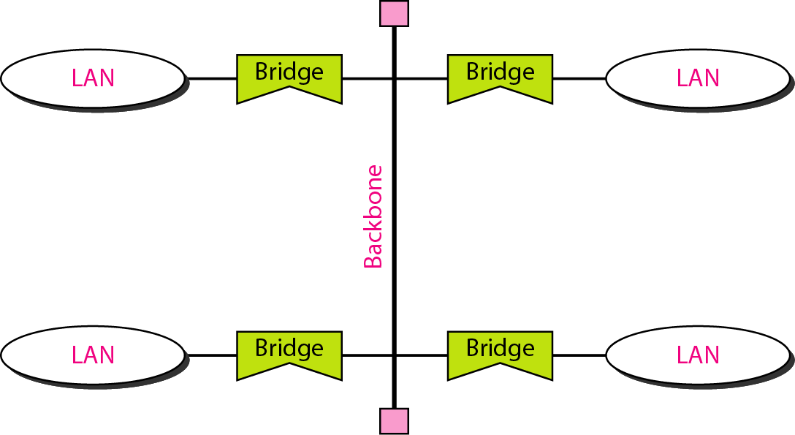
Figure 15.12 Bus backbone

Slide 22
Note
In a star backbone, the topology of the backbone is a star;
the backbone is just one switch.

Slide 23
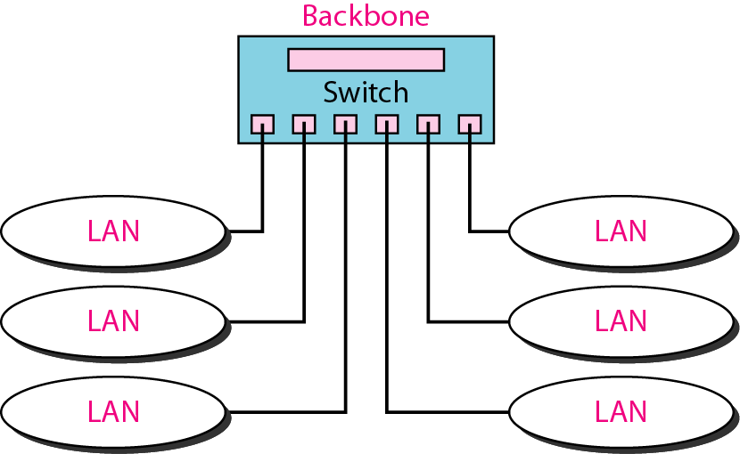
Figure 15.13 Star backbone

Slide 24
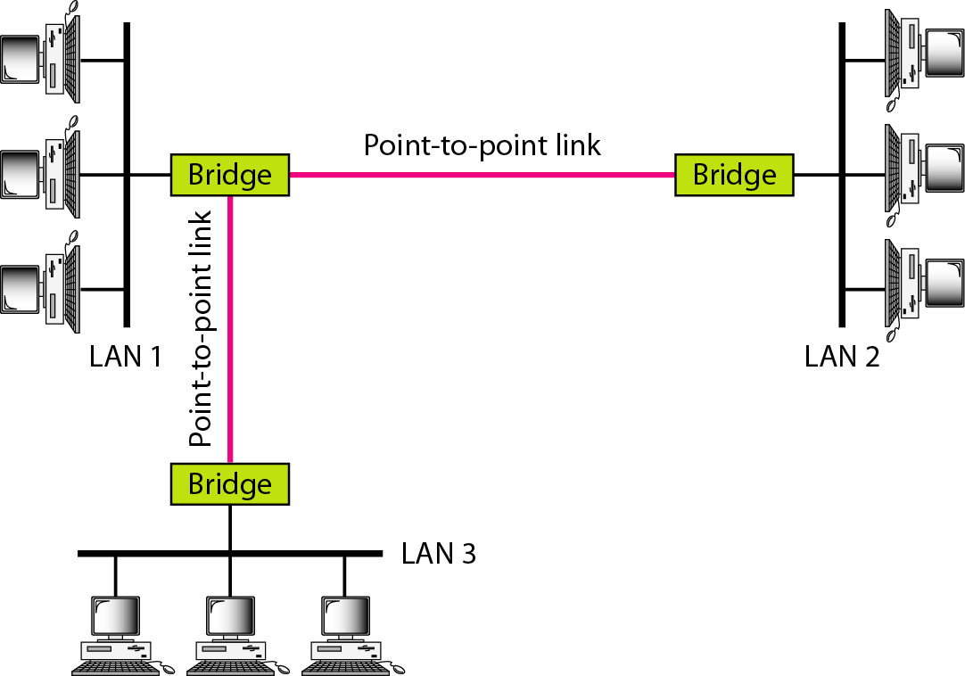
Figure 15.14 Connecting remote LANs with bridges

Slide 25
Note
A point-to-point link acts as a LAN in a remote backbone connected by
remote bridges.

Slide 26
Routers
  Operates at network layer = deals with packets not frames
  Connect LANs and WANs with similar or different protocols together
  Acts like normal stations on a network, but have more than one network address (an address to each connected network)
  Deals with global address ( network layer address (IP)) not local address (MAC address)
  Routers Communicate with each other and exchange routing information
  Determine best route using routing algorithm by special software installed on them
  Forward traffic if information on destination is available otherwise discard it (not like a switch or bridge)

Slide 27

Figure Routers connecting independent LANs and WANs
Routers

Slide 28
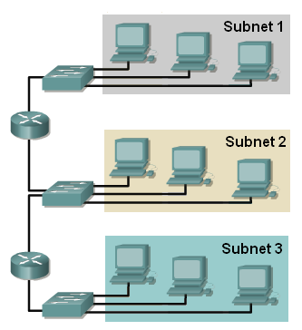
Virtual LANs
3 Collision domains
3 Broadcast domains
If we want to move computers from group1 to group3, then rewiring (physical replacement) has to be done
What is the alternative solution??
VLAN: Virtual (logical) Local Area Network : Local Area Network configured by software not by physical wiring

Slide 29
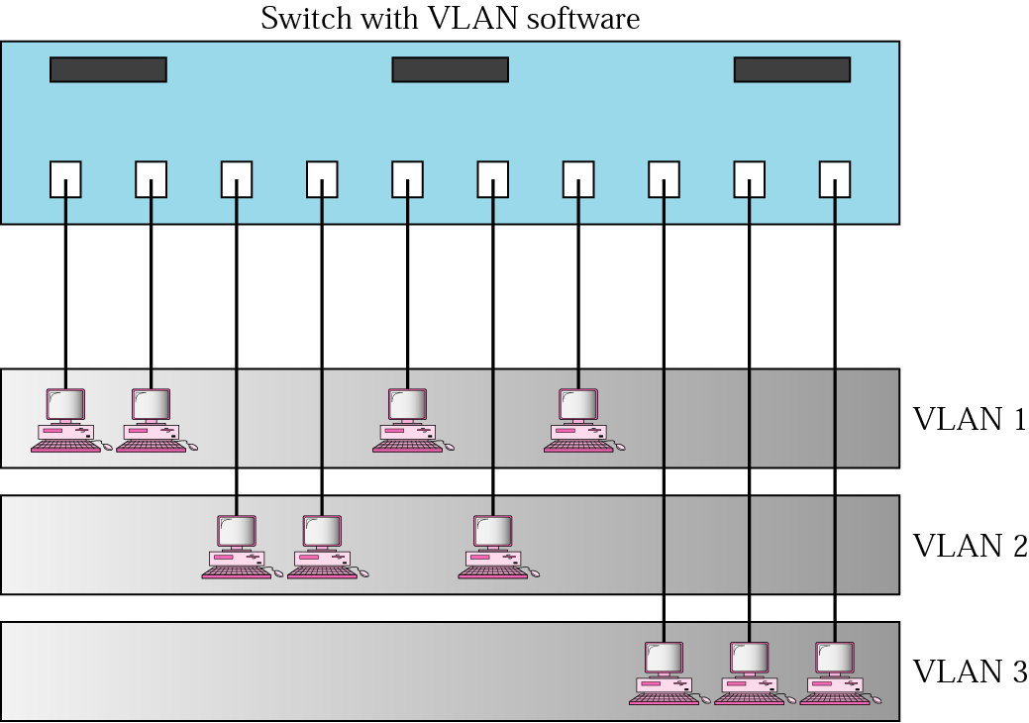
Figure A switch using VLAN software
VLAN1: Ports 1,2,5,7
VLAN2: Ports 3,4,6
VLAN3: Ports 8,9,10
1
2
3
4
5
6
7
8
9
10
Separate broadcast domain ➔ separate network
Using the Virtual LAN technology will allow grouping computers logically instead of physically.
VLAN divides the physical LAN into several Logical LANs called VLANs
Switch maintains a look up table to know to which LAN a machine belongs to.

Slide 30

Figure Two switches in a backbone using VLAN software

Slide 31
Advantages Of VLAN
Reduce cost and installation time:
  Instead of physically moving a station to another segment or another switch, it can be moved by software.
Increase security:
  A group of users needing a high security can be put into a VLAN so that NO users outside the VLAN can communicate with them.
  Stations belong to the same group can send broadcast messages that will NOT be received by users in others VLAN groups
Creating Virtual Workgroups
  Stations located at physically different locations can be added easily to the same broadcast domain so that they can send broadcast messages to one another.
    EXAMPLE: people from different departments working on the same project

